Slide 1
Systems Analysis and Design 9th Edition
Chapter 3
Managing Systems Projects
Part 1

Slide 2
Chapter Objectives
Explain project planning, scheduling, monitoring, and reporting
Describe work breakdown structures, task patterns, and critical path analysis
Explain techniques for estimating task completion times and costs

Slide 3
Chapter Objectives
Describe various scheduling tools, including Gantt charts and PERT/CPM charts
Analyze task dependencies, durations, start dates, and end dates
Describe project management software and how it can assist you in project planning, estimating, scheduling, monitoring, and reporting

Slide 4
Chapter Objectives
Discuss the importance of project risk management
Understand why projects sometimes fail

Slide 5
Introduction
You will learn about project planning, estimating, scheduling, monitoring, reporting, and the use of project management software
You also will learn how to control and manage project changes as they occur

Slide 6
Overview of Project Management
Project Management
A successful project must be completed on time, within budget, and deliver a quality product that satisfies users and meets requirements
Project manager or project leader
Project coordinator

Slide 7
Overview of Project Management
What Does a Project Manager Do?
Project manager, project leader
Project planning
Project scheduling
Project monitoring and controlling
Project reporting

Slide 8
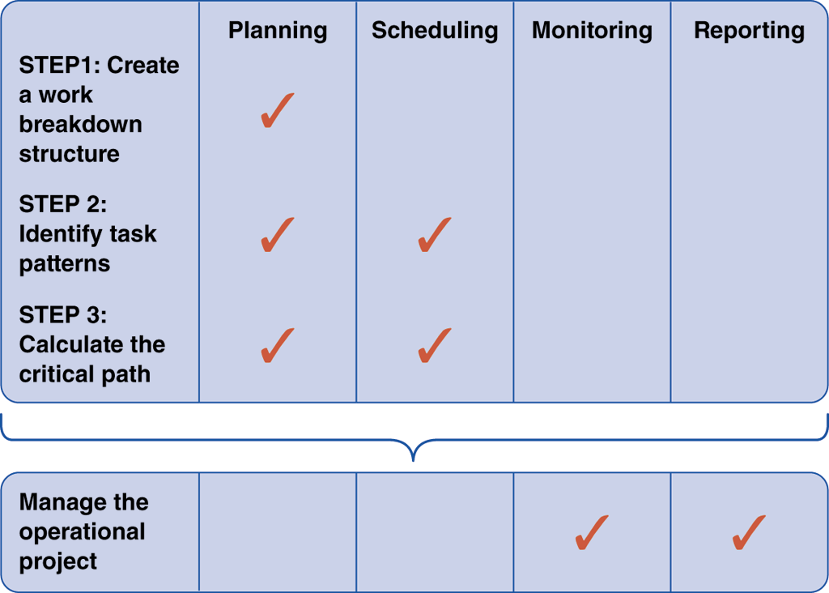
Overview of Project Management
Project Activities and Planning Steps

Slide 9
Step 1: Create a Work Breakdown Structure
Work breakdown structure (WBS)
What is a Gantt Chart?
Task group
Can present an overview of the project’s status, but does not provide detailed information that is necessary when managing a complex project

Slide 10
Step 1: Create a Work Breakdown Structure
What is a PERT/CPM Chart?
The Program Evaluation Review Technique (PERT)
Critical Path Method (CPM)
The distinction between the two methods has disappeared over time

Slide 11
Step 1: Create a Work Breakdown Structure
What is a PERT/CPM Chart ?
PERT/CPM is called a bottom-up technique
Project tasks
Once you know the tasks, their duration, and the order in which they must be performed, you can calculate the time that it will take to complete the project

Slide 12
Step 1: Create a Work Breakdown Structure
Which Type of Chart is Better?
Although a Gantt chart offers a valuable snapshot view of the project, PERT charts are more useful for scheduling, monitoring, and controlling the actual work
PERT and Gantt charts are not mutually exclusive techniques, and project managers often use both methods

Slide 13
Step 1: Create a Work Breakdown Structure
Identifying Tasks in a Work Breakdown Structure
Task or activity
Event or milestone
Break the project down into smaller tasks, creating a work breakdown structure

Slide 14
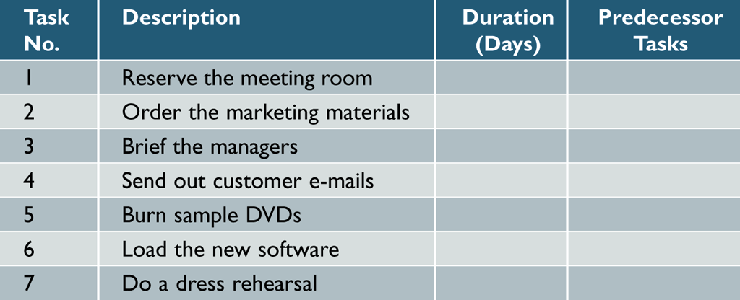
Step 1: Create a Work Breakdown Structure
Identifying Tasks in a Work Breakdown Structure
Listing the tasks
Can be challenging, because the tasks might be embedded in a document
Create a table with columns for task number, description, duration, and predecessor tasks

Slide 15
Step 1: Create a Work Breakdown Structure
Identifying Tasks in a Work Breakdown Structure
Estimating Task Duration
Person-days
Best-case estimate (B)
Probable-case estimate (P)

Slide 16
Step 1: Create a Work Breakdown Structure
Identifying Tasks in a Work Breakdown Structure
Estimating Task Duration
Worst-case estimate (W)
Weight
(B+4P+W)
6

Slide 17
Step 1: Create a Work Breakdown Structure
Identifying Tasks in a Work Breakdown Structure
Factors Affecting Duration
Project size and scope
Human resources
Experience with similar project
constraints

Slide 18
Step 1: Create a Work Breakdown Structure
Displaying the Work Breakdown Structure
If you are managing a complex project with many tasks, you can use task groups, just as you would in a Gantt chart, to simplify the list

Slide 19
Step 2: Identify Task Patterns
Task pattern
What are Task Patterns?
Large or small, tasks depend on each other and must be performed in a sequence, not unlike the commands in a software program
Task patterns can involve dependent tasks, multiple successor tasks, and multiple predecessor tasks

Slide 20
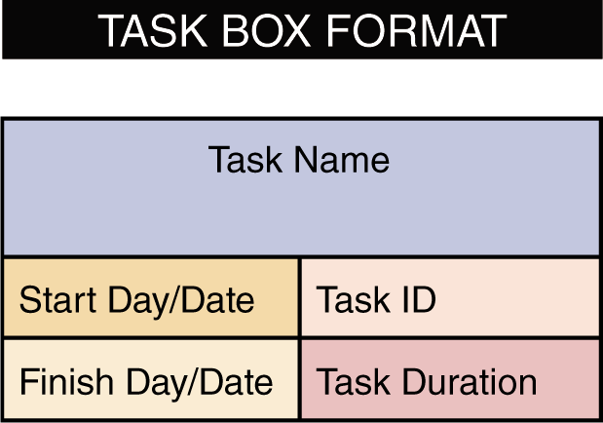
Step 2: Identify Task Patterns
How do I Use Task Boxes to Create a Model?

Slide 21
Step 2: Identify Task Patterns
What are the Main Types of Task Patterns?
Dependent Tasks
Multiple successor tasks
Concurrent task
Predecessor task
Successor task
Multiple Predecessor Tasks

Slide 22
Step 2: Identify Task Patterns
How Do I Identify Task Patterns?
You can identify task patterns by looking carefully at the wording of the task statement
Words like then, when, or and are action words that signal a sequence of events
How Do I Work With Complex Task Patterns?
When various task patterns combine, you must study the facts carefully in order to understand the logical sequence

Slide 23
Step 2: Identify Task Patterns
How Do I Work With Complex Task Patterns?
Consider the following three fact statements and the task patterns they represent
Dependent tasks
Dependent tasks and multiple successor tasks
Dependent tasks, multiple successor tasks, and multiple predecessor tasks

Slide 24
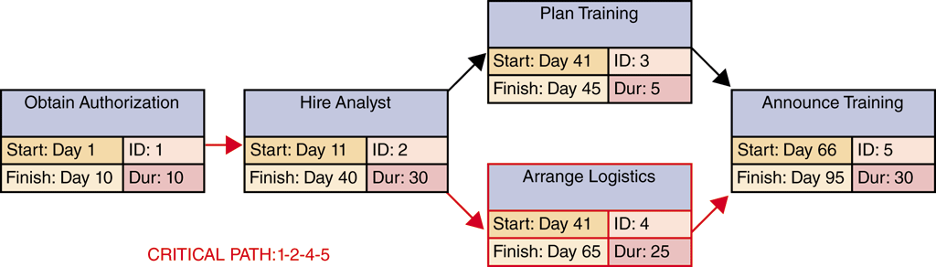
Step 3: Calculate the Critical Path
What Is a Critical Path?

Slide 25
Step 3: Calculate the Critical Path
How Do I Calculate the Critical Path?
First, you should review the task patterns
The next step is to determine start and finish dates, which will determine the critical path for the project
Slack time

Slide 26
Project Monitoring and Control
Monitoring and Control Techniques
The project manager must keep track of tasks and progress of team members, compare actual progress with the project plan, verify the completion of project milestones, and set standards and ensure that they are followed
Structured walkthrough
Called design reviews, code reviews, or testing reviews

Slide 27
Project Monitoring and Control
Maintaining a Schedule
Maintaining a project schedule can be a challenging task
The better the original plan, the easier it will be to control the project
If enough milestones and frequent checkpoints exist, problems will be detected rapidly
Project managers often spend most of their time tracking the tasks along the critical path

Slide 28
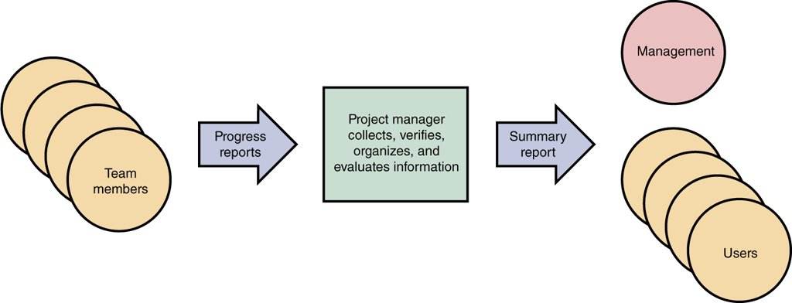
Reporting
Members of the project team regularly report their progress
Project Status Meetings

Slide 29
Reporting
Project Status Reports
A project manager must report regularly to his or her immediate supervisor, upper management, and users
Should explain what you are doing to handle and monitor the problem
Most managers recognize that problems do occur on most projects; it is better to alert management sooner rather than later

Slide 30
Project Management Examples
PERT/CPM Example
You construct a PERT/CPM chart from this task list in a two-step process
Step 1: Create the work breakdown structure
Step 2: Enter start and finish times

Slide 31
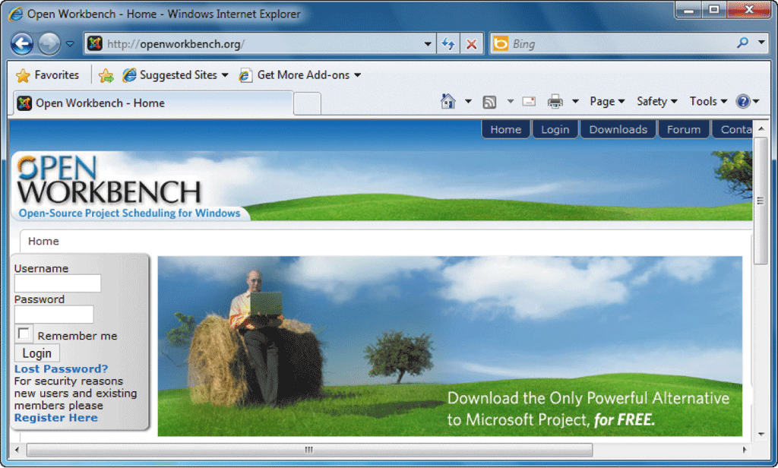
Project Management Examples
Software-Driven Example
Open Workbench
Open-source software
When you use project management software, you follow the same step-by-step process to develop a WBS and create various types of charts

Slide 32
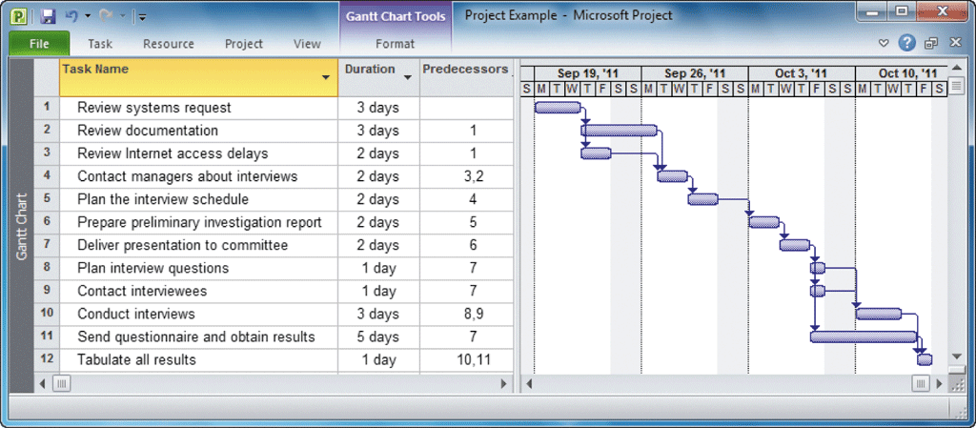
Project Management Examples
Software-Driven Example
Work breakdown structure
Gantt chart
Network diagram
Project planning is a dynamic task and involves constant change

Slide 33
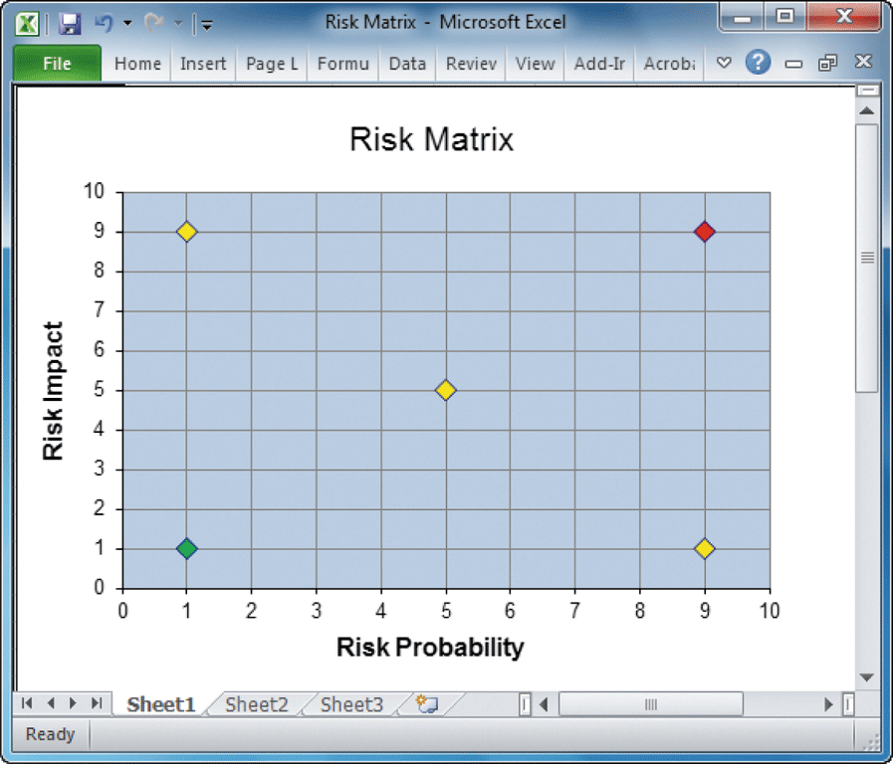
Risk Management
Every IT project involves risks that systems analysts and project managers must address
Risk management
Steps in Risk Management
Develop risk management plan
Identify the risks
Risk identification

Slide 34
Risk Management
Steps in Risk Management (continued)
Analyze the risks
Qualitative risk analysis
Quantitative risk analysis
Create a risk response plan
Monitor risks

Slide 35
Risk Management
Risk Management Software
Most project management software includes powerful features
The IT team can make a recommendation regarding the risks
Depending on the nature and magnitude of the risk, the final decision might be made by management

Slide 36
Managing for Success
Business Issues
The major objective of every system is to provide a solution to a business problem or opportunity
A system that falls short of business needs also produces problems for users and reduces employee morale and productivity
Project creep

Slide 37
Managing for Success
Budget Issues
Cost overruns typically result from one or more of the following:
Unrealistic estimates
Failure to develop an accurate forecast that considers all costs over the life of the project
Poor monitoring of progress and slow response to early warning signs of problems

Slide 38
Managing for Success
Budget Issues
Cost overruns typically result from one or more of the following:
Schedule delays due to factors that were not foreseen
Human resource issues, including turnover, inadequate training, and motivation

Slide 39
Managing for Success
Schedule Issues
Problems with timetables and project milestones can indicate a failure to recognize task dependencies, confusion between effort and progress, poor monitoring and control methods, personality conflicts among team members, or turnover of project personnel

Slide 40
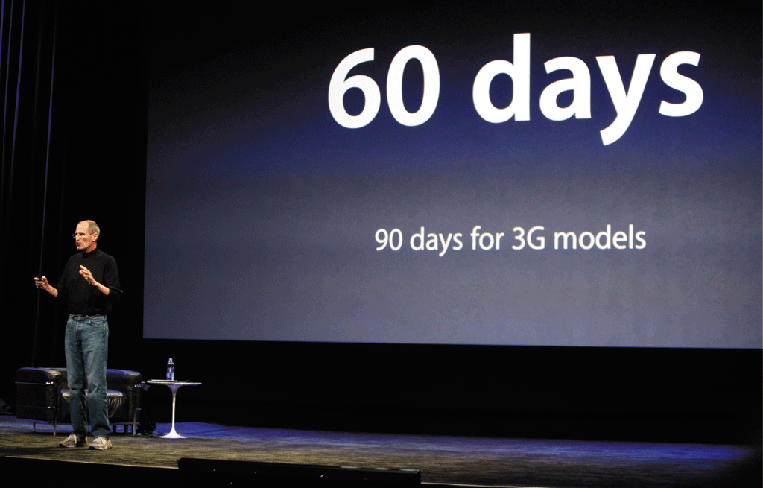
The Bottom Line
When problems occur, the project manager’s ability to handle the situation becomes the critical factor

Slide 41
The Bottom Line
Sometimes, when a project experiences delays or cost overruns, the system still can be delivered on time and within budget if several less critical requirements are trimmed
Brooks’ Law

Slide 42
Chapter Summary
Project management is the process of planning, scheduling, monitoring and controlling, and reporting upon the development of an information system
Project managers are responsible for project planning, scheduling, monitoring, and reporting
Planning, scheduling, monitoring and reporting all take place within a larger project development framework
Notes:
49

Slide 43
Chapter Summary
In project scheduling, the project manager develops a specific time for each task, based on available resources and whether or not the task is dependent on other predecessor tasks
Every successful information system must support business requirements, stay within budget, and be available on time
Sound project management involves the same skills as any other management
Notes:
49

Slide 44
Chapter Summary
Chapter 3 complete

